Slide 1

Identify the typology of Early Childhood education through Parents’ perception: A Latent class analysis of ECPP:2016
Yi Chen
Advanced Topics in Research Methods and Design

Slide 2
Background & Literature Review
A child’s early years are the foundation for his or her future development, providing a strong base for lifelong learning and learning abilities, including cognitive and social development. Well-established research continues to emphasize the importance of early childhood education as an essential building block of a child’s future success.
Many people have reservations about the importance of pre-kindergarten education. This was clearly manifest in 2006 when the California legislature unsuccessfully attempted to pass a law that would make pre-school education mandatory for all children. Meanwhile, according to some studies, children enrolled in preschool programs are more behaved and have higher IQ scores upon enrolling kindergarten and learn quicker than their peers without formal education.
Conventional Typology of early childhood education:
Child care by relatives
Child care by non-relatives
Day Care Center
Preschool Program

Slide 3
Research Question
Does there exist latent classes for the believe of early childhood education from parents?
How children and family background related to the estimated latent classes?
How does the background of children and the latent class together effect children’s learning?

Slide 4
Sample
The National Household Education Surveys Program (NHES) is the flagship household survey program of the National Center for Education Statistics (NCES), collects nationally representative, descriptive data on the educational activities of children and adults in the United States. NHES:2016 used a nationally representative address-based sample covering the 50 states and the District of Columbia.
Data about young children‘s care and education before kindergarten are collected in the NHES’s Early Childhood Program Participation Survey (ECPP:2016).
The whole survey in this study children in the United States from birth through the age of 5 who were not yet enrolled in kindergarten by 2016. In this study, we only keep the children older than 2 years.
After removing the data set which miss all the value in the indicator, 3871 children are included in this study.

Slide 5
Method: three-step LDA model
In this study the three-step latent class analysis (LCA) model is applied to identify distinct early childhood education in United States based on the information from parents about the main reason for choosing care (i.e., what factors were important to parents when choosing a care arrangement). Mplus is used for model estimation, R is used for data transformation and descriptive analysis, and Excel and draw.io is used for visualization.
The three-step LDA model is able to:
1. Identify the homogeneous subgroups of early childhood education;
2. Explore covariates that help to explain the likelihood of belonging to a particular subgroup of early childhood education;
3. Explain the distal outcomes that are associated with subgroup belonging .

Slide 6
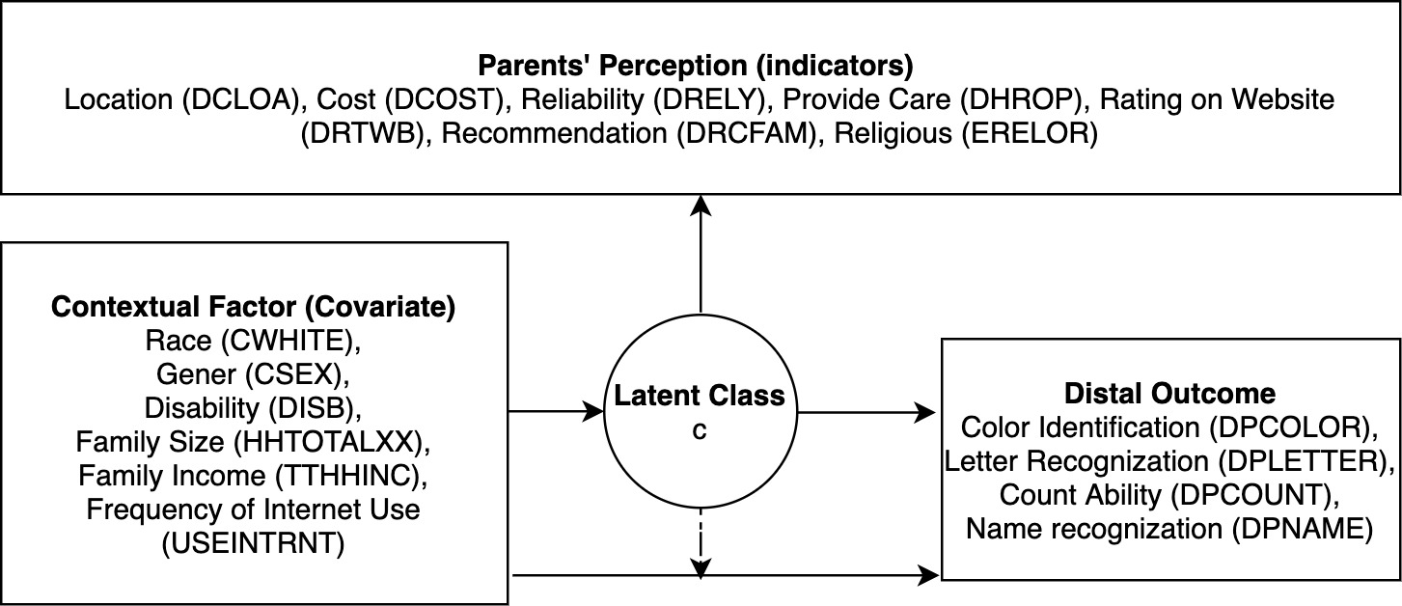
Method: three-step LDA model

Slide 7
Step One: Descriptive Analysis of the Indicator variables of LCA
Variables | N | Min | Max | Mean | SD | ECPP:2016 Variable
Location of arrangement | 3871 | 1 | 4 | 3.434 | 0.790 | CDLOA
Cost of arrangement | 3871 | 1 | 4 | 3.247 | 0.903 | DCOST
Reliability of arrangement | 3871 | 1 | 4 | 3.813 | 0.516 | DRELY
The learning activity at the arrangement | 3871 | 1 | 4 | 3.719 | 0.563 | DLERN
The child spending time with other kids his/her age | 3871 | 1 | 4 | 3.550 | 0.773 | DCHIL
The times during the day that this caregiver is able to provide care | 3871 | 1 | 4 | 3.560 | 0.752 | DHROP
The number of other children in the child’s care group | 3871 | 1 | 4 | 3.106 | 0.893 | DNBGRP
Ratings on a website | 3871 | 1 | 4 | 2.576 | 1.135 | DRTWEB
Recommendation from friends and family | 3871 | 1 | 4 | 3.192 | 0.967 | DRECFAM
Religious orientation of the program | 3871 | 1 | 4 | 2.022 | 1.136 | DRELOR
Note：
1. The descriptive analysis is based on the original data, in which all 10 indicators are measured in four level Likert scale from ‘not at all important’ to ‘very important’.
2. All indicators are dichotomized by setting ‘not at all important’ and ‘a little important’ as 0 and ‘somewhat important’ and ‘very important’ as 1, when input into the LDA model.

Slide 8
Step One: LCA results and fit statistics for Early Childhood Education
Model | AIC | Adjusted BIC | - Log likelihood | - BLRT | P-value (BRLT) | LMR | P-value (LMR) | Entropy
Two Classes | 30756.580 | 30821.339 | 15357.290 | 16199.000 | 0.000 | 1665.097 | 0.000 | 0.623
Three Classes | 30456.748 | 30555.428 | 15196.374 | 15357.290 | 0.000 | 318.329 | 0.009 | 0.671
Four Classes | 30202.608 | 30335.208 | 15058.304 | 15196.374 | 0.000 | 273.135 | 0.000 | 0.663
Five Classes | 30048.916 | 30215.438 | 14970.458 | 15058.304 | 0.000 | 173.779 | 0.000 | 0.681
Six Classes | 30022.038 | 30222.481 | 14946.019 | 14970.458 | 0.000 | 48.346 | 0.017 | 0.647
Note (Bold values are the best fit model based on adjusted BIC)
Information criteria:
AIC: Akaike Information Criteria;
Adjusted BIC: Sample-size adjusted Bayesian Information Criteria;
Comparative Model fit (compare with k-1):
LMR: Lo‐Mendell‐Rubin Adjusted Likelihood Ratio Test;
- BLRT: the negative H0 loglikelihood of Bootstrap Loglikelihood ratio test;

Slide 9
Class Enumeration Processes Classification Probabilities for the Most Likely Latent Class Membership
Latent Classes | 1 | 2 | 3 | 4 | 5
1 | 0.531 | 0.220 | 0.236 | 0.006 | 0.008
2 | 0.011 | 0.843 | 0.142 | 0.000 | 0.004
3 | 0.033 | 0.132 | 0.807 | 0.002 | 0.026
4 | 0.051 | 0.000 | 0.076 | 0.816 | 0.057
5 | 0.005 | 0.030 | 0.111 | 0.009 | 0.845
Notes:
latent class 1 has low identification ability

Slide 10
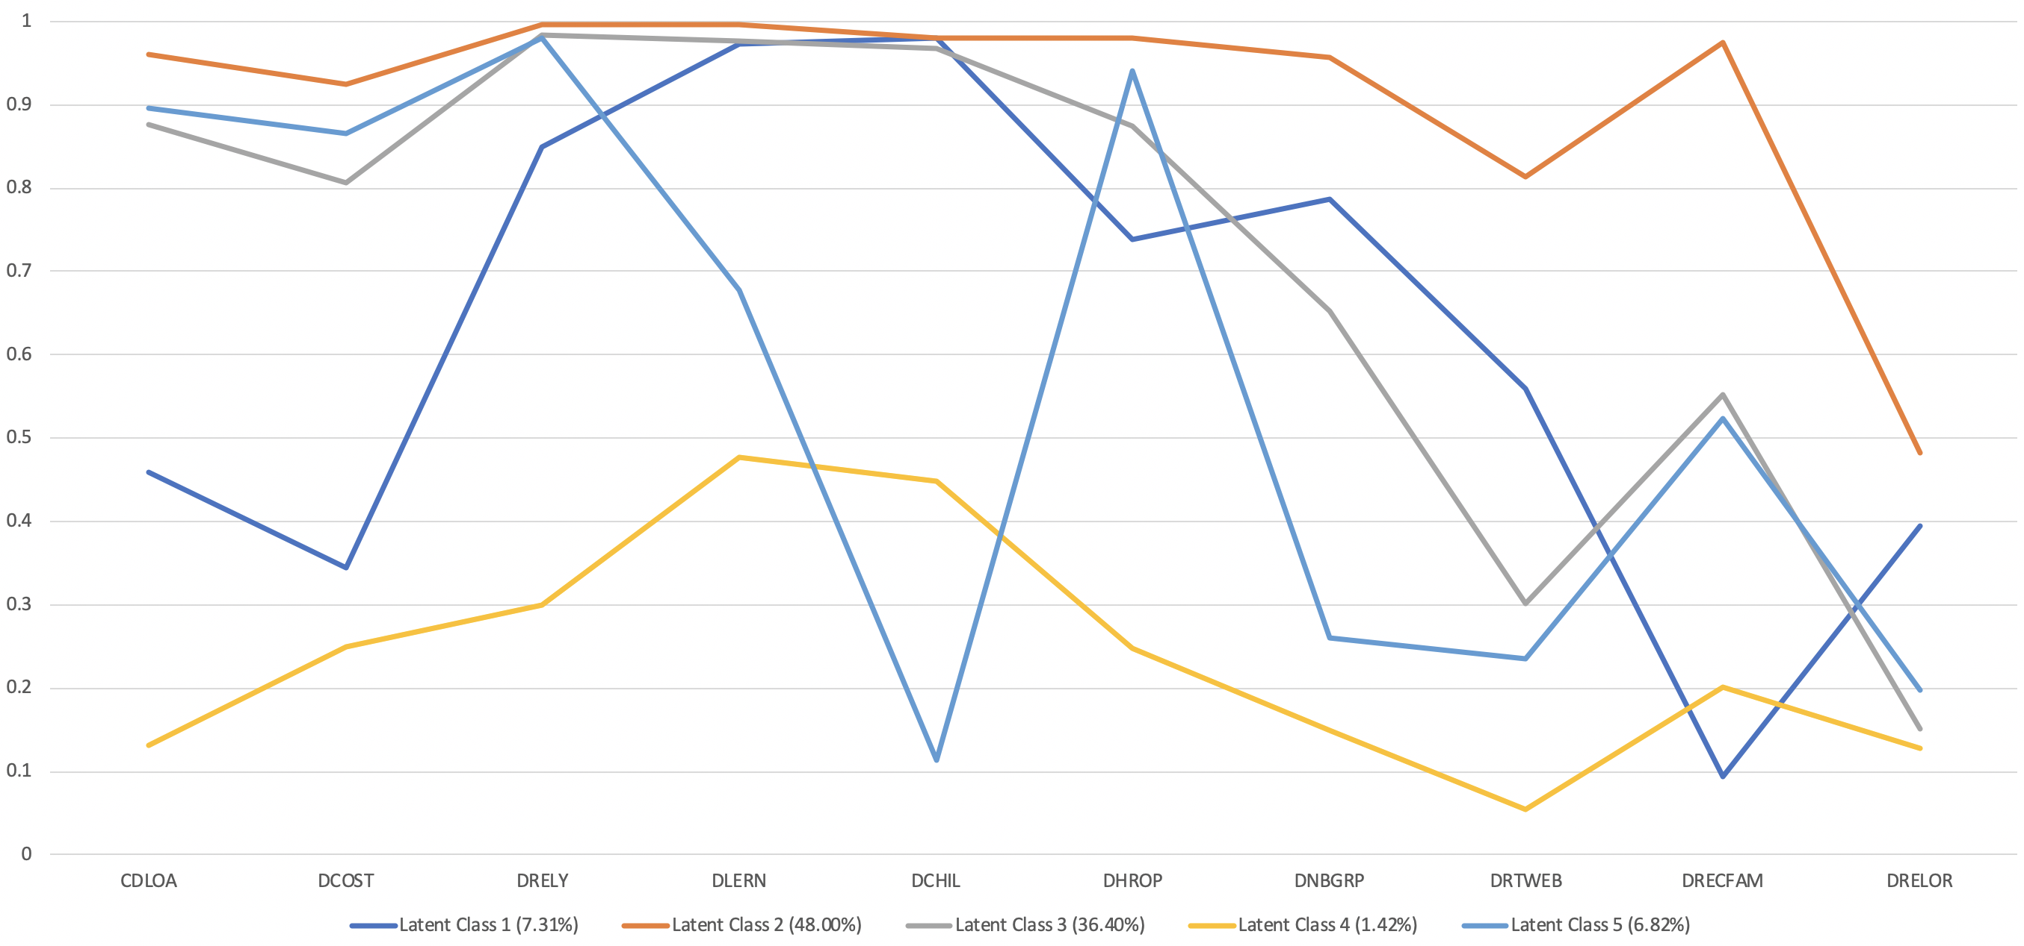
Latent Classes
Proportion of parent with above average importance
Notes:
latent class 1: learning and peer, religious is relatively important, not follow the recommendation from the families
latent class 2: versatile (high importance on everything)
latent class 3: self-orientated
latent class 4: demoralized (low importance on everything)
latent class 5: just need an easy way to take care of their children

Slide 11
Step Two: Descriptive Analysis of the Covariates
Variables | N | Min | Max | Mean | SD | ECPP:2016 Variable
Children’s Race (white or not) | 3871 | 0 | 1 | 0.806 | 0.396 | CWHITE
Children’s Gender (male or not) | 3871 | 0 | 1 | 0.514 | 0.499 | CSEX
Whether Children Has any Kind of Disability and Disturbance | 3871 | 0 | 1 | 0.123 | 0.327 | HDINTDIS,HDSPEECHX,HDDISTRBX,HDDEAFIMX,HDBLINDX,HDORTHOX,HDAUTISMX,HDPDDX,HDADDX,HDLEARNX,HDDELAYX,HDTRBRAIN,HDOTHERX
Number of people living in the family | 3871 | 0 | 9 | 3.813 | 1.188 | HHTOTALXX
Frequency of using Internet | 3871 | 0 | 4 | 2.719 | 0.489 | USEINTRNT
Total income of the family | 3871 | 0 | 9 | 2.550 | 2.802 | TTLHHINC
Note：
The variable about disability is based on 13 specific disability or disturbance in the original data set. If the children has at least one condition, he/she will has value of 1. Otherwise, it is transformed as 0 (i.e., do no have any kinds of disability or disturbance).
Number of people live in the family is transformed by setting as 0 if the family have four or less than four people (i.e., small size family). Otherwise, it is transformed as 1 (i.e., big size family).
Frequency of Using internet is transformed by setting as 1 if the family use the internet more than several time a week (i.e., high frequency). Otherwise, it is transformed as 0 (i.e., low frequency)
Total income of the family is transformed by setting as 0 if the total income is fewer or equal to 50,000 (i.e., low income family). Otherwise, the it is transformed as 0 (i.e., high income family).

Slide 12
Step Two of LCA: mean and odd ratio for covariates with latent class 2 as the reference group
Covariates | Latent class 1 (7.31%) |  |  | Latent class 3 (36.4%) |  |  | Latent class 4 (1.42%) |  |  | Latent class 5 (6.82%)
 | mean | Odd Ratio | P-value | mean | Odd Ratio | P-value | mean | Odd Ratio | P-value | mean | Odd Ratio | P-value
Disability | 0.131 | 1.140 | 0.641 | 0.184 | 1.202 | 0.290 | 1.081 | 2.948 | 0.005** | -0.554 | 0.574 | 0.119
Number of People | 0.201 | 1.223 | 0.292 | -0.559 | 0.572 | 0.000*** | 0.879 | 2.408 | 0.004** | 0.167 | 1.182 | 0.335
Internet Use | -0.255 | 0.775 | 0.683 | 0.801 | 2.229 | 0.214 | -0.060 | 0.942 | 0.942 | -0.028 | 0.972 | 0.969
Family Income | 0.426 | 1.530 | 0.055. | 0.053 | 1.054 | 0.678 | -0.371 | 0.690 | 0.241 | 1.094 | 2.985 | 0.000***
Gender | 0.096 | 1.101 | 0.598 | 0.077 | 1.081 | 0.499 | -0.215 | 0.806 | 0.519 | 0.132 | 1.141 | 0.427
Race | 1.479 | 4.390 | 0.000*** | 1.008 | 2.739 | 0.000*** | 0.269 | 1.309 | 0.428 | 0.732 | 2.080 | 0.002**

Slide 13
Step Three: Descriptive Analysis of the Distal Outcome
Variables | N | Min | Max | Mean | SD | ECPP:2016 Variable
Color identification | 3871 | 0 | 2 | 1.373 | 0.863 | DPCOLOR
Letter reorganization | 3871 | 0 | 3 | 1.435 | 1.214 | DPLETTER
Count Ability | 3871 | 0 | 5 | 2.274 | 1.635 | DPCOUNT
Whether kid can write the first word even backward | 3871 | 0 | 1 | 0.385 | 0.486 | DPNAME
Note：
The children under the age of 2 (884 observations in total) are not required to answer these question about children’s learning. This lead to the planned missing in response caused by the rotation design.
In this study, all missing value will be set as 0, which correspond to the situation that the children do not mater these skills.

Slide 14
Step Three of LCA: Mean and Standard Deviation of Outcome across Latent Classes
Outcome Variables | Latent Class 1 |  | Latent Class 2 |  | Latent Class 3 |  | Latent Class 4 |  | Latent Class 5
 | Mean | SD | Mean | SD | Mean | SD | Mean | SD | Mean | SD
Color identification | 0.903 | 0.027 | 0.776 | 0.013 | 0.865 | 0.016 | 0.715 | 0.075 | 0.654 | 0.053
Letter reorganization | 0.722 | 0.039 | 0.588 | 0.016 | 0.596 | 0.022 | 0.589 | 0.083 | 0.385 | 0.058
Count Ability | 0.810 | 0.036 | 0.664 | 0.015 | 0.674 | 0.021 | 0.527 | 0.084 | 0.514 | 0.058
Whether kid can write the first word even backward | 0.752 | 0.054 | 0.516 | 0.016 | 0.514 | 0.022 | 0.452 | 0.084 | 0.307 | 0.041
Notes:
In general, latent class 1 has the best performance, latent class 5 has the lowest performance.
Most childhood education specialists claim that young children learn best when they're not pushed too hard, they have an opportunity to interact with their peers, and their parents and instructors treat them kindly.

Slide 15
Step Three of LCA: Pearson pairwise test of mean with latent class 2 as the reference group
Outcome Variables | Latent Class 1 |  | Latent Class 3 |  | Latent Class 4 |  | Latent Class 5
 | Chi-square | P-value | Chi-square | P-value | Chi-square | P-value | Chi-square | P-value
Color identification | 16.195 | 0.000*** | 14.470 | 0.000*** | 0.645 | 0.422 | 4.988 | 0.026
Letter reorganization | 9.084 | 0.003** | 0.074 | 0.786 | 0.000 | 0.998 | 11.449 | 0.001***
Count Ability | 13.000 | 0.000*** | 0.113 | 0.737 | 2.556 | 0.110 | 6.305 | 0.012
Whether kid can write the first word even backward | 20.625 | 0.000*** | 0.005 | 0.945 | 0.569 | 0.451 | 17.204 | 0.000***
Notes:
latent class 4 and latent class 2 are almost not difference. important on every thing and not important on everything is the same.

Slide 16
Discuss
Conclusion:
Based on the data, there are 5 distinct latent class of parents’ perception about early childhood education.
The background information of the kids and family, to some extent, can explain the difference among the latent classes.
The latent class has significant difference in their learning outcome.
Limitation:
The interpretation of the latent classes need to be linked with the theory in the filed of early childhood education.
Latent class 2 dominate the whole sample, which has high value on all indicators.
More context variable and outcome variables may need to take into consideration.
The results from the three-step LCA is not correlational rather than casual. Since the ECPP is a longitudinal survey, it may have potential for exploring the causation.

Slide 17
Thank you

